Slide 1
8
CHAPTER
Linear Algebra:
Matrix Eigenvalue Problems

Slide 2
8.1 The Matrix Eigenvalue Problem. Determining
Eigenvalues and Eigenvectors

Slide 3
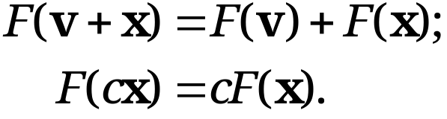
7.9 Vector Spaces, Inner Product
Spaces, Linear Transformations
Linear Transformations (Revisiting)
DEFINITION
A linear mapping/transformation F for all vectors v and x in vector space X and scalar c, satisfy linearity attributes
(10)
Every linear mapping or transformation F from space X=R^{n} into space Y=R^{m} can be given as an m × n matrix A,
(11) y = Ax.
after a basis for R^{n} , {e_{(i=1,..,n)}}, and a basis for R^{m} , {e_{(i=1,..,m)}}, are both chosen.
Section 7.9 p<number>

Slide 4
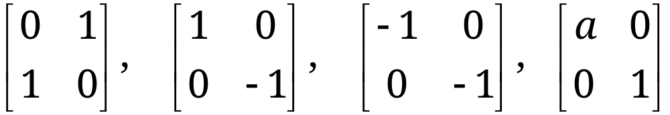
7.9 Vector Spaces, Inner Product
Spaces, Linear Transformations
EXAMPLES 5 & 6 Linear Transformations
As transformations of 2-D Cartesian coordinates in the plane,
examples above represent 1) a reflection in the line x₂=x₁; 2) a reflection in the x₁-axis; 3) a reflection in the origin; and 4) a stretch in the x₁ -direction, respectively
Question: How to distinguish linear transformations that are direction preserving (stretching only like Eg. 4) for [x_{1,} x₂], from those that are not (involving rotation like Eg. 1-3) ??
This is what Matrix Eigen Analysis aims to achieve. It is widely used in many applications in engineering, physics, economics, and many other research areas.
Section 7.9 p<number>

Slide 5
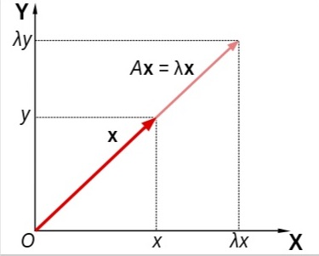
8.0 Linear Algebra: Matrix Eigenvalue Problems
Introduction To Matrix Eigen Analysis
Consider the vector equation
(1) Ax = λx.
Here, A is a given n×n square matrix, λ is an unknown scalar, and x is an unknown n×1 column vector.
Matrix eigenvalue problem: aims to find all λ’s and non-trivial x’s (x ≠ 0) that satisfy Equation (1)
Matrix A stretches vector x, but not changing its direction. Hence, x is an eigenvector of A.
  x = 0 is the trivial solution for any λ and thus not interesting – we only consider solutions with x ≠ 0

Slide 6
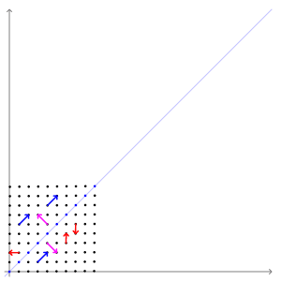
8.0 Linear Algebra: Matrix Eigenvalue Problems
Introduction To Matrix Eigen Analysis
A transformation matrix
preserves the direction of
vectors parallel to [1 −1]^{T}
(purple) and [1 1]^{T} (blue)
The red vectors are not parallel to either of the two eigenvectors, and the linear transformation altered their directions.

Slide 7

8.0 Linear Algebra: Matrix Eigenvalue Problems
Example of Mat. Eigen Analysis (Image Shearing)
The blue arrow is a unit length (Eigenvalue = 1) direction preserving Eigenvector of the image shearing transform; the red arrow is NOT.

Slide 8
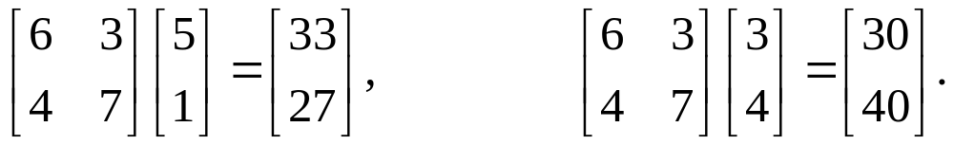
8.1 The Matrix Eigenvalue Problem. Determining
Eigenvalues and Eigenvectors
Consider multiplying nonzero vector by a given matrix, e.g.,
We are interested in the influence of the multiplication of a given matrix on the vectors
  Case I: we get a different vector from the original one, with a different direction and length
  Case II: we get a new vector with the same direction as the original one; the scale constant, λ = 10
Matrix eigenvalue problem
  The problem of systematically finding λ’s and nonzero vectors x’s that satisfy Equation (1)
Section 8.1 p<number>

Slide 9
8.1 The Matrix Eigenvalue Problem. Determining
Eigenvalues and Eigenvectors
Remarks:
Geometrically, we are looking for vectors, x, for which Ax has the same or opposite direction as x
λ is called an eigenvalue or characteristic value of the matrix A. (“Eigen” is German and means “proper” or “characteristic.”)
The corresponding solutions x ≠ 0 of (1) are called the eigenvectors or characteristic vectors of A corresponding to that eigenvalue λ.
The set of all the eigenvalues of A is called the spectrum of A. The largest of the absolute values of the eigenvalues of A is called the spectral radius of A.
Section 8.1 p<number>

Slide 10
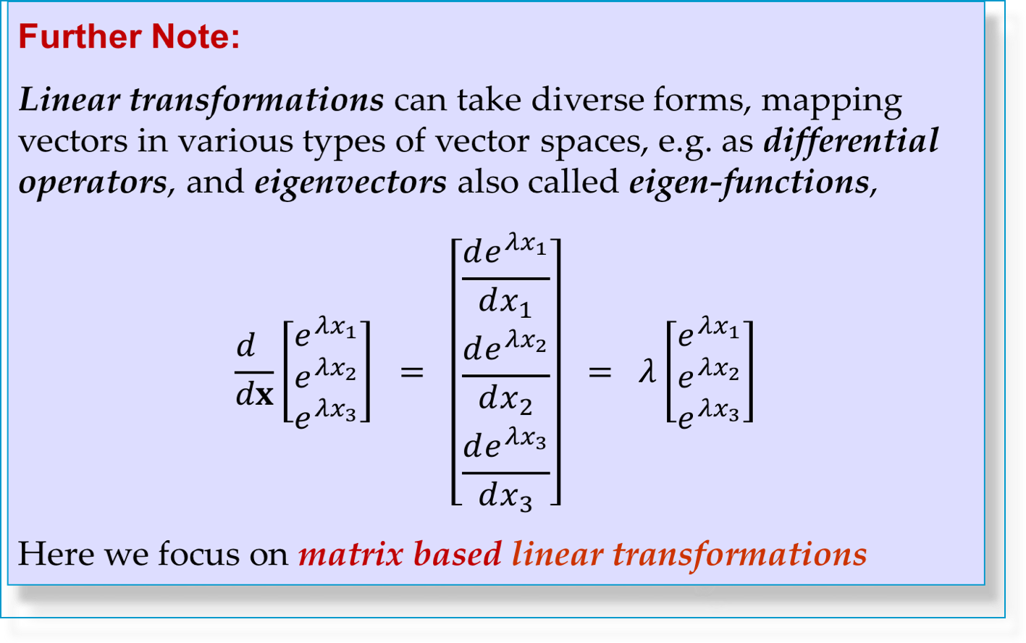
8.1 The Matrix Eigenvalue Problem. Determining
Eigenvalues and Eigenvectors
Section 8.1 p<number>

Slide 11
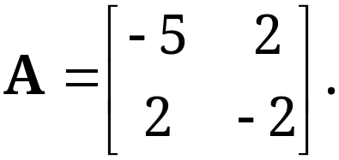
8.1 The Matrix Eigenvalue Problem. Determining
Eigenvalues and Eigenvectors
How to Find Eigenvalues and Eigenvectors
EXAMPLE 1
Determination of Eigenvalues and Eigenvectors
We illustrate all the steps in terms of the matrix
Section 8.1 p<number>

Slide 12
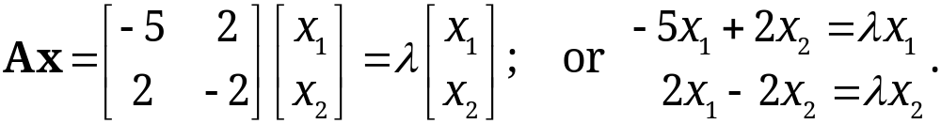
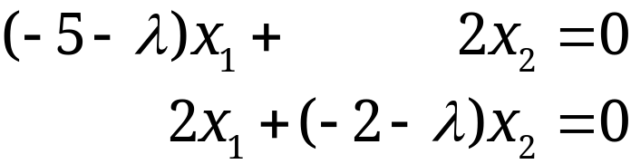
8.1 The Matrix Eigenvalue Problem. Determining
Eigenvalues and Eigenvectors
EXAMPLE 1 (continued 1)
Solution.
(a) Eigenvalues. They must be determined first. Equation (1) is
Moving the terms on the right to the left, we obtain
(2*)
This can be written in matrix form
(3*) (A − λI)x = 0,
because Ax − λx = Ax − λIx = (A − λI)x = 0.
homogeneous linear system!
Section 8.1 p<number>

Slide 13
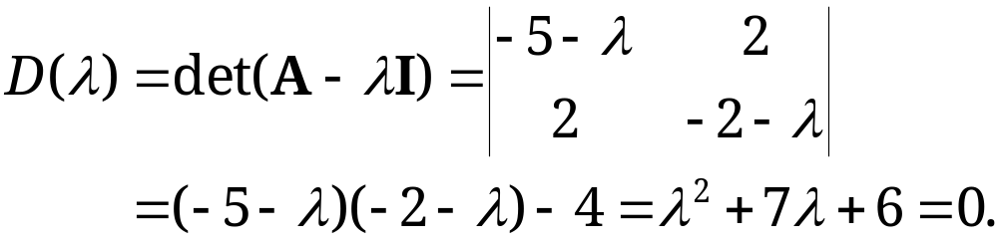
8.1 The Matrix Eigenvalue Problem. Determining
Eigenvalues and Eigenvectors
EXAMPLE 1 (continued 2)
Solution. (continued 1)
Equation (3) has nonzero solution if and only if rank (A-λI) <2, i.e., determinant of its coefficient matrix is zero. Thus,
(4*)
D(λ) is the characteristic determinant, or if expanded, the characteristic polynomial
D(λ) = 0 is called the characteristic equation of A
The solutions of this quadratic equation are λ₁ = −1 and λ₂ = −6 (eigenvalues of A are now determined)
Section 8.1 p<number>

Slide 14
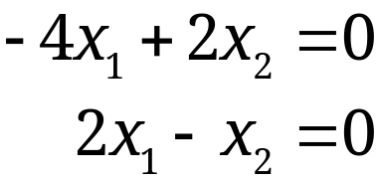

8.1 The Matrix Eigenvalue Problem. Determining
Eigenvalues and Eigenvectors
EXAMPLE 1 (continued 3)
Solution. (continued 2)
(b₁) Eigenvector of A corresponding to λ₁. This vector is obtained from (2*) with λ = λ₁ = −1, that is,
A solution to the above equations is x₂ = 2x₁. This determines an eigenvector corresponding to λ₁ = −1 up to a scalar multiple.
If we choose x₁ = 1, we obtain the eigenvector x₁=[1 2]^{T}
Section 8.1 p<number>

Slide 15
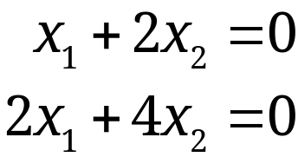

8.1 The Matrix Eigenvalue Problem. Determining
Eigenvalues and Eigenvectors
EXAMPLE 1 (continued 4)
Solution. (continued 3)
(b₂) Eigenvector of A corresponding to λ₂. For λ = λ₂ = −6, equation (2*) becomes
A solution is x₂ = −x₁/2 with an arbitrary x₁
If we choose x₁ = 2, we get x₂ = −1. Thus, an eigenvector of A corresponding to λ₂ = −6 is x₂=[2 -1]^{T}
Section 8.1 p<number>

Slide 16
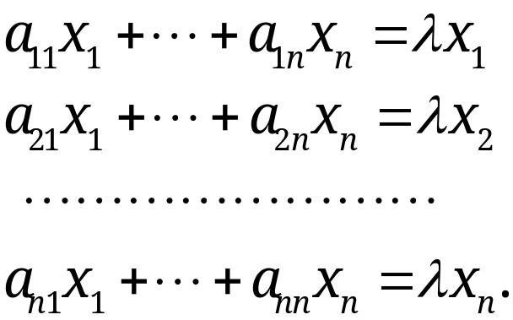
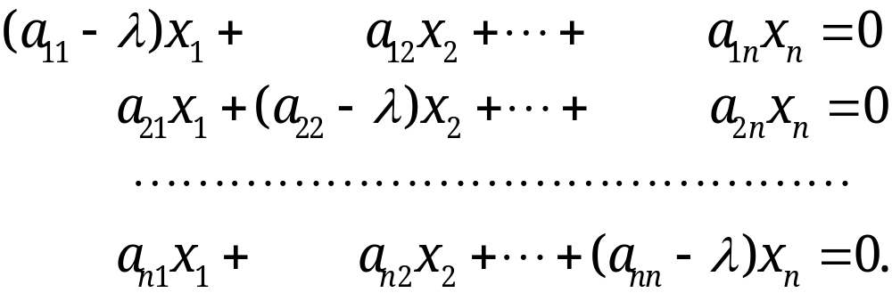
8.1 The Matrix Eigenvalue Problem. Determining
Eigenvalues and Eigenvectors
How to Find Eigenvalues and Eigenvectors
For general eigenvalue problem Ax= λx with n×n matrix A, we have
Moving the terms on the right side to the left side, we have
(2)
Section 8.1 p<number>

Slide 17
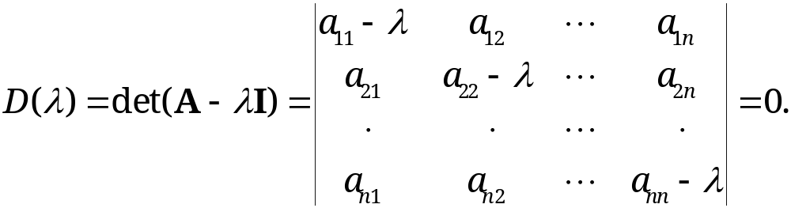
8.1 The Matrix Eigenvalue Problem. Determining
Eigenvalues and Eigenvectors
In matrix form,
(3) (A – λI) x = 0.
Homogeneous linear system (3) has a nonzero solution if and only if the corresponding determinant of the coefficient matrix is zero:
(4)
By expanding D(λ), we can obtain a polynomial of nth degree in λ, called characteristic polynomial of A, from which we can solve for the eigenvalues
Section 8.1 p<number>

Slide 18
8.1 The Matrix Eigenvalue Problem. Determining
Eigenvalues and Eigenvectors
Remarks:
A – λ I is called the characteristic matrix and D(λ) the characteristic determinant of A. Equation (4) is called characteristic equation of A.
Eigenvalues must be determined first! Once they are known, the corresponding eigenvectors are obtained from (2) by substituting to it the eigenvalue λ.
If x is eigenvector of λ, then cx is also an eigenvector of λ, where c is any nonzero scalar. An eigenvector x is determined only up to a constant factor.
We can also choose to normalize x, that is, transform it to a unit vector by multiplying it by a scalar
Section 8.1 p<number>

Slide 19
8.1 The Matrix Eigenvalue Problem. Determining
Eigenvalues and Eigenvectors
Theorem 1
Eigenvalues
The eigenvalues of a square matrix A are the roots of the characteristic equation (4) of A.
An n × n matrix has at least one eigenvalue and at most n numerically different eigenvalues.
CAUTION! A real matrix may have complex eigenvalues and eigenvectors (see Example 4 below)
Section 8.1 p<number>

Slide 20
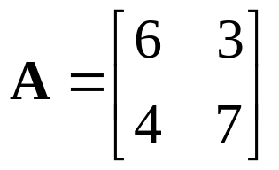


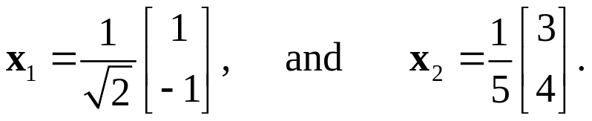
8.1 The Matrix Eigenvalue Problem. Determining
Eigenvalues and Eigenvectors
EXERCISE 1
Find the eigenvalues and the normalized eigenvectors of
Solution
  The characteristic equation is
  Eigenvalues are
  The corresponding normalized eigenvectors are
Section 8.1 p<number>
Notes:
First break

Slide 21
8.1 The Matrix Eigenvalue Problem. Determining
Eigenvalues and Eigenvectors
Theorem 2
Eigenvectors and Eigenspace
If w and x are eigenvectors of a matrix A corresponding to the same eigenvalue λ, so are w + x (provided x ≠ −w) and kx for any k ≠ 0.
The eigenvectors corresponding to the same eigenvalue λ of A, together with 0, form a vector space, called the Eigenspace of A corresponding to that λ.
Proof
Since Aw= λw and Ax= λx, A(w+x)= Aw +Ax=λ(w+x) and A(k x) =k Ax = λ (kx). Thus, Theorem 2 holds.
Section 8.1 p<number>

Slide 22
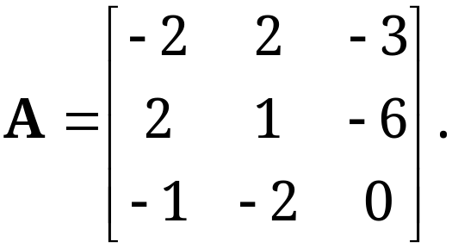
8.1 The Matrix Eigenvalue Problem. Determining
Eigenvalues and Eigenvectors
EXAMPLE 2 Multiple Eigenvalues
Find the eigenvalues and eigenvectors of
Solution.
The characteristic determinant gives the characteristic equation:
D(λ) = |A- λI| = -(λ +3)²(λ–5) = 0.
The roots (eigenvalues of A) are λ₁ = 5, λ₂ = λ₃ = −3.
Section 8.1 p<number>

Slide 23
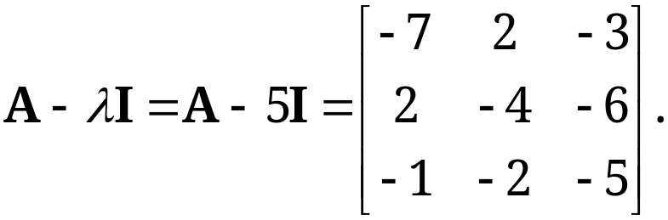
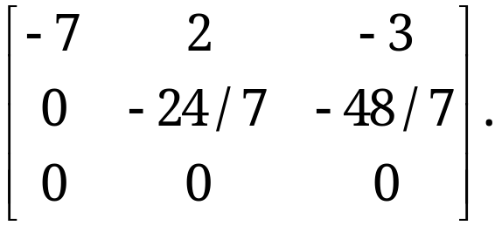
8.1 The Matrix Eigenvalue Problem. Determining
Eigenvalues and Eigenvectors
EXAMPLE 2 Multiple Eigenvalues (continued 1)
Solution. (continued 1)
To find eigenvectors, we apply Gauss elimination (Sec. 7.3) to the system (A − λI)x = 0.
For λ = 5 the characteristic matrix is
Its row-echelon form is
Hence it has rank 2.
Section 8.1 p<number>

Slide 24
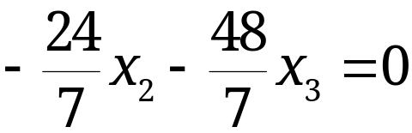
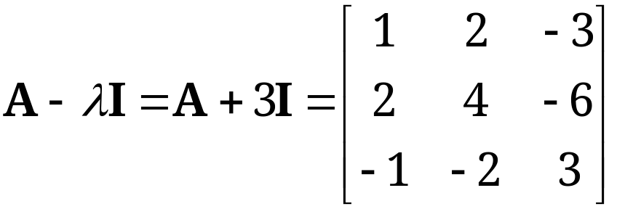
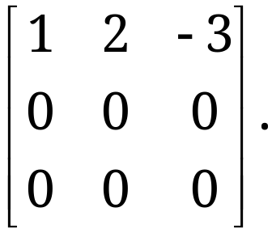
8.1 The Matrix Eigenvalue Problem. Determining
Eigenvalues and Eigenvectors
EXAMPLE 2 Multiple Eigenvalues (continued 2)
Solution. (continued 2)
Choosing x₃ = −1 we have x₂ = 2 from and then x₁ = 1 from −7x₁ + 2x₂ − 3x₃ = 0.
Thus, an eigenvector of A corresponding to λ = 5 is [1 2 -1]^{T}.
For λ = −3, the characteristic matrix
Gaussian elimination yields
Hence it has rank 1.
Section 8.1 p<number>

Slide 25
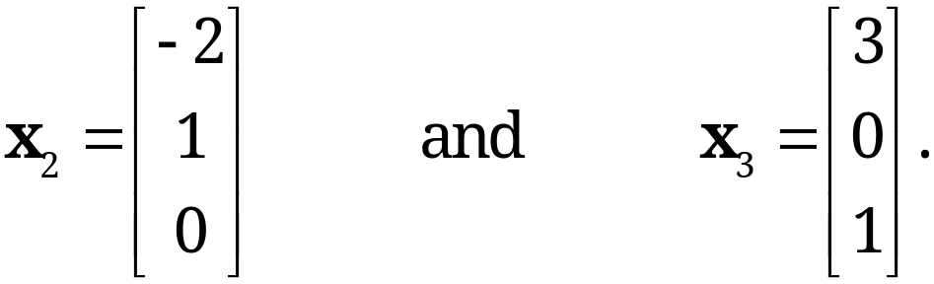
8.1 The Matrix Eigenvalue Problem. Determining
Eigenvalues and Eigenvectors
EXAMPLE 2 Multiple Eigenvalues (continued 3)
Solution. (continued 3)
From x₁ + 2x₂ − 3x₃ = 0, we have x₁ = −2x₂ + 3x₃. Choosing (x₂, x₃)= (1, 0) and (x₂, x₃)= (0, 1), we obtain two linearly independent eigenvectors of A corresponding to λ = −3 (Recall from Sec. 7.5, nullity (dimensionality of solution space)
of A = n-rank A = 3-1 = 2),
Section 8.1 p<number>

Slide 26
8.1 The Matrix Eigenvalue Problem. Determining
Eigenvalues and Eigenvectors
EXAMPLE 2 Multiple Eigenvalues (continued 3)
Solution. (continued 3)
From x₁ + 2x₂ − 3x₃ = 0, we have x₁ = −2x₂ + 3x₃. Choosing (x₂, x₃)= (1, 0) and (x₂, x₃)= (0, 1), we obtain two linearly independent eigenvectors of A corresponding to λ = −3 (Recall from Sec. 7.5, nullity (dimensionality of solution space)
of A = n-rank A = 3-1 = 2),
Section 8.1 p<number>

Slide 27
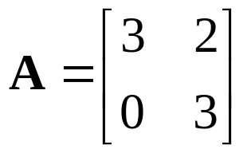



8.1 The Matrix Eigenvalue Problem. Determining
Eigenvalues and Eigenvectors
Algebraic and Geometric Multiplicity
The order M_{λ} of an eigenvalue λ as a root of the characteristic polynomial of n degree is the algebraic multiplicity of λ; the sum of all of them equals to n
The number m_{λ} of linearly independent eigenvectors corresponding to λ is called geometric multiplicity of λ; m_{λ} is the dimension of the Eigenspace corresponding to λ
In general, m_{λ} ≤ M_{λ}; and ∆_{λ} = M_{λ} - m_{λ} is called defect of λ
Example 3 Algebraic and Geometric Multiplicity, Positive Defect
Find the algebraic, geometric multiplicity of eigenvalues of
Section 8.1 p<number>

Slide 28
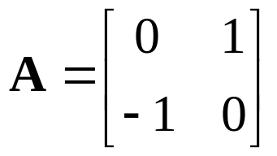
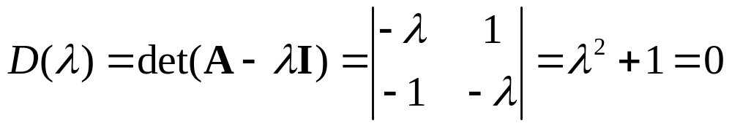
8.1 The Matrix Eigenvalue Problem. Determining
Eigenvalues and Eigenvectors
Example 4 Real Matrices with Complex Eigenvalues and Eigenvectors
Since real polynomials may have complex roots, a real matrix may have complex eigenvalues and eigenvectors
Consider the following matrix A
Its characteristic equation is
Thus, it has two eigenvalues: λ₁=i, and λ₂=-i. The corresponding eigenvectors are [1 i]^{T} and [1 -i]^{T}
Section 8.1 p<number>

Slide 29
8.1 The Matrix Eigenvalue Problem. Determining
Eigenvalues and Eigenvectors
Theorem 3
Eigenvalues of the Transpose
The transpose A^{T} of any square matrix A has the same eigenvalues as A.
Proof.
The characteristic determinant of matrix A is |A-λI|; while that of matrix A^{T} is |A^{T} -λI|. Since
|A^{T} -λI| = |(A –λI)^{T}| = |A-λI|,
the transpose A^{T} has the same characteristic determinant as matrix A. Therefore, the transpose A^{T} has the same eigenvalues as A.
Section 8.1 p<number>

Slide 30
8.2 Some Applications
of Eigenvalue Problems

Slide 31
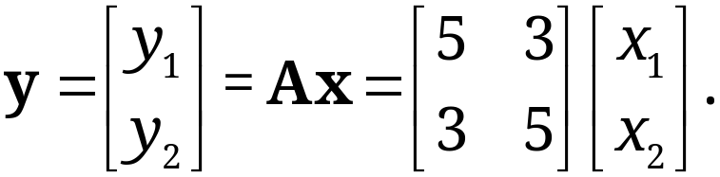
8.2 Some Applications of Eigenvalue Problems
EXAMPLE 1 Stretching of an Elastic Membrane
An elastic membrane in the x₁x₂-plane with boundary circle x₁² + x₂² = 1 (Fig. 160) is stretched so that a point P: (x₁, x₂) goes over into the point Q: (y₁, y₂) given by
(1)
Questions:
Find the principal directions (i.e., the directions of the position vector x of P for which the direction of the position vector y of Q is the same or opposite)
What shape does the boundary circle take under this deformation?
Section 8.2 p<number>

Slide 32
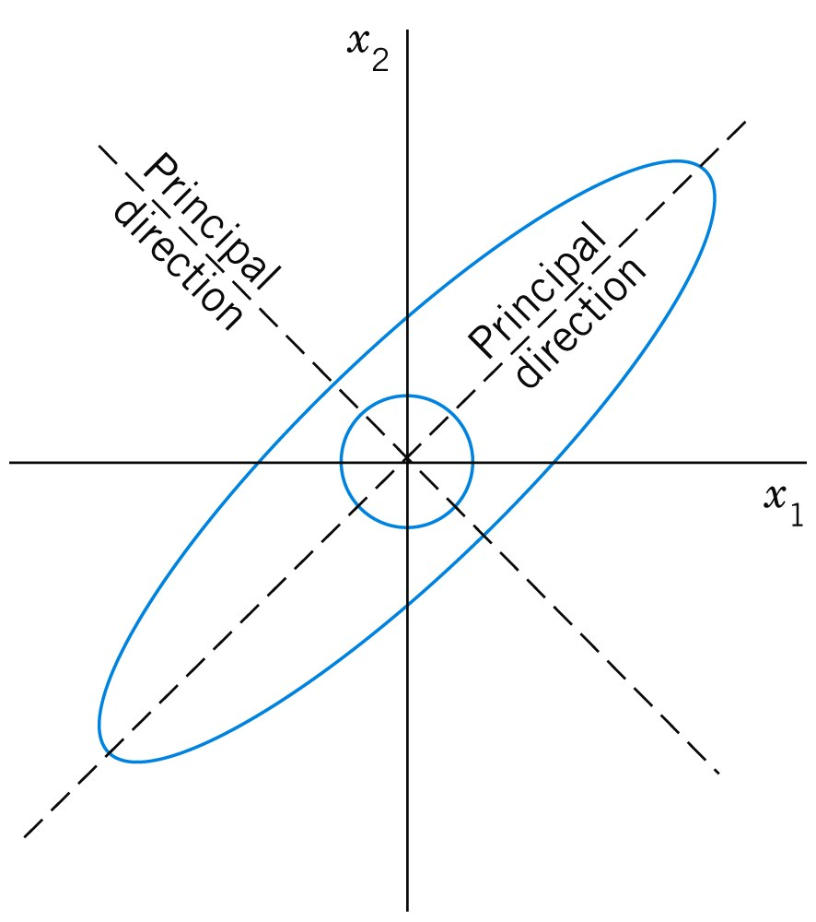
8.2 Some Applications of Eigenvalue Problems
EXAMPLE 1 (continued 1)
Stretching of an Elastic Membrane
Fig. 160. Undeformed and deformed membrane in Example 1
Section 8.2 p<number>

Slide 33
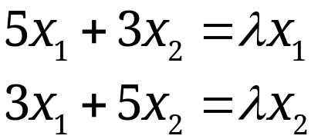
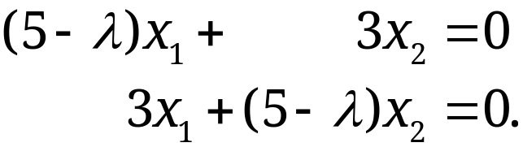
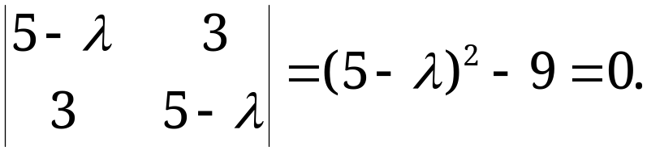
8.2 Some Applications of Eigenvalue Problems
EXAMPLE 1 (continued 2)
Stretching of an Elastic Membrane
Solution.
We are looking for vectors x such that y = λx. Since y = Ax, this gives Ax = λx, the equation of an eigenvalue problem. In components, Ax = λx is
(2) or
The characteristic equation is
(3)
Its solutions are λ₁ = 8 and λ₂ = 2, which are the eigenvalues of our problem.
Section 8.2 p<number>

Slide 34
8.2 Some Applications of Eigenvalue Problems
EXAMPLE 1 (continued 3)
Stretching of an Elastic Membrane
Solution. (continued 2)
For λ=λ₁=8, our system (2) becomes
−3x₁ + 3x₂ = 0, Solution x₂ = x₁, x₁ arbitrary,
3x₁ − 3x₂ = 0. for instance, x₁ = x₂ = 1.
For λ= λ₂=2, our system (2) becomes
3x₁ + 3x₂ = 0, Solution x₂ = −x₁, x₁ arbitrary,
3x₁ + 3x₂ = 0. for instance, x₁ = 1, x₂ = −1.
Thus, we obtain two principal directions [1, 1] and [1, -1]
The eigenvalues show that in principal directions the membrane is stretched by λ factors 8 and 2, respectively
Section 8.2 p<number>

Slide 35
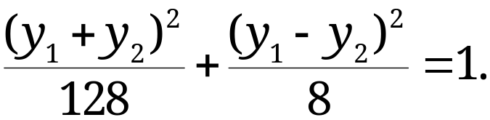
8.2 Some Applications of Eigenvalue Problems
EXAMPLE 1 (continued 4)
Stretching of an Elastic Membrane
Solution. (continued 3)
Observe that
Then, we have
Therefore, the boundary circle under this deformation becomes an ellipse, with the two principal directions being y₁+y₂=0 and y₁-y₂=0, respectively.
Section 8.2 p<number>

Slide 36
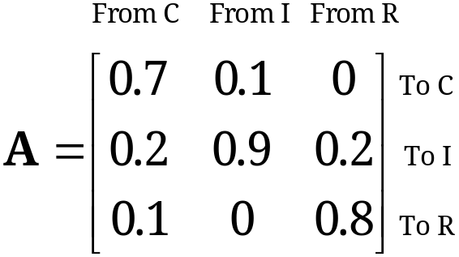
8.2 Some Applications of Eigenvalue Problems
EXAMPLE 2 Eigenvalue Problems Arising from Markov Processes
Suppose that the 2004 state of land use in a city of 60 mi² of built-up area is
C: Commercially Used 25%; I: Industrially Used 20%; R: Residentially Used 55%
Question 1: find the states in 2009 and 2014, assuming that the transition probabilities for 5-year intervals are given by the matrix A and remain practically the same over the time considered
Solution.
Land usage vector (in %) in 2004: LUV₂₀₀₄=[25, 20, 55]^{T}
Land usage vector (in %) in 2009: LUV₂₀₀₉=A LUV₂₀₀₄=[19.5, 34, 46.5]^{T}
Land usage vector (in %) in 2014:
LUV₂₀₁₄=A LUV₂₀₀₉=A² LUV₂₀₀₄=[17.05, 43.8, 39.15]^{T}
Five year land use
transition matrix
Section 8.2 p<number>

Slide 37
8.2 Some Applications of Eigenvalue Problems
EXAMPLE 2 (continued)
Question 2: after many five years, will the land usage vector (in %) converge to some fixed vector? That is: for large N, will
A^{N} LUV₂₀₀₄ = LUV_{SS}.
becomes a constant vector? In other words, LUV_{SS} is not changed by further multiplying of A to it. Hence,
A LUV_{SS} = LUV_{SS}.
To solve it, we need to do two things:
  To show that matrix A indeed has an eigenvalue of value 1.
  To find the eigenvector of A corresponding to the eigenvalue of value 1. This gives the value of LUV_{SS}.
Solution: The matrix A has an eigenvalue of value 1. Thus, there exists such an LUV_{SS}, and LUV_{SS} =100 [2/9 6/9 1/9]^{T}
Steady state
This is an eigenvalue problem!
Section 8.2 p<number>

Slide 38
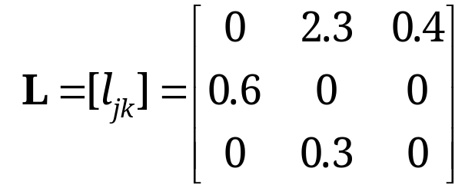
8.2 Some Applications of Eigenvalue Problems
EXAMPLE 3 Eigenvalue Problems Arising from Population Models
The Leslie model describes age-specified population growth as follows:
Let the oldest age attained by the females in some animal population be 9 years. Divide the population into three age classes of 3 years each.
Let the “Leslie matrix” describing between age group migration be
where l_{1k} is the average number of daughters born to a single female during the time she is in age class k, and l_{j, j-1} (j=2, 3) is the fraction of females in age class j-1 that will survive and get re-assigned into age class j later in time
Questions:
What is the number of females in each class after 3, 6, 9 years if each class initially consists of 400 females?
For what initial distribution will the number of females in each class change by the same population? What is this rate of change?
Section 8.2 p<number>

Slide 39
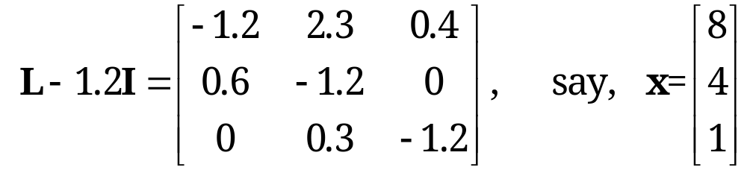
8.2 Some Applications of Eigenvalue Problems
EXAMPLE 3 (continued)
Solution: Initially, x₍₀₎=[400 400 400]^{T}. After three years,
x₍₃₎=L x₍₀₎= [1080 240 120] ^{T}.
Similarly, after six years the number of females in each class is x₍₆₎=L x₍₃₎= [600 648 72] ^{T}; and after nine years, x₍₉₎=L x₍₆₎= [1519.2 360 194.1] ^{T}.
Proportional change means that we look for an initial distribution vector x such that any 3-year change is given by Lx=λx, where λ is the rate of change (grow if λ>1, and decrease if λ<1). The characteristic equation is
det (L - λI) = -λ³+1.38λ+0.072 = 0.
A positive root is found to be λ=1.2. A corresponding eigenvector x can be determined from the characteristic matrix
Thus, the distribution is 8: 4: 1, and the growth rate is 1.2 per 3 years.
Section 8.2 p<number>

